Slide 1


Text Summarization
Heriot Watt University , Dubai Campus 2019/2020
Bruce Tauro – H00228269
Mohamed Serry - H00313456
Salah Tamer - H00343334
Tarek Itani - H00292565

Slide 2
summary
/ˈsʌm(ə)ri/
noun
a brief statement or account of the main points of something.
"a summary of Chapter Three"
Similar:
synopsis
precis
résumé
abstract
abridgement
digest

Slide 3
“Automatic text summarization is the task of using computers to
produce a concise and fluent summary while preserving key
information content and overall meaning ”
Text Summarization Techniques: A Brief Survey 2017

Slide 4
“I apologize for such a long letter - I didn't have time to write a short one.”
― Blaise Pascal
Notes:
While we conceive that the more, we write , the more effort we do , yet the less we think. Summarization required thinking (Deep Thinking ☺ ) ,, and in Machine world, It require processing Power…

Slide 5

History
Initially pioneered by Hans Peter Luhn in 1950 at IBM.
Existence and availability of internet
Increase of amount of data
Need:
Important data time

Slide 6
Applications of Text Summarization
Marketing Search – SEO / Social Media
Chatbots (QnA)
Legal Contract Analysis
Books / Document Summarization
Media Monitoring
Text Classification

Slide 7
Extractive Summarization: Extractive summarization rely on extracting content in the form of pieces text and concatenating them to create a summary
Abstractive Summarization: The abstractive summarization generate entirely new text from the original one, to the extent that some parts of the generated text are not in the original corpus .
Types of Text Summarization

Slide 8
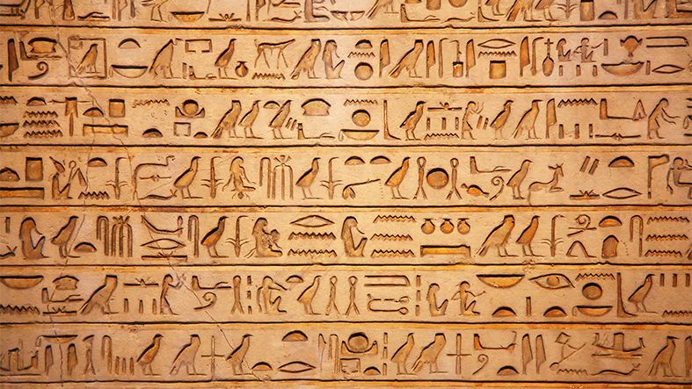
Abstractive Text Summarization
Notes:
Summary don’t need to come from the same text

Slide 9
Abstractive Summarization
Generate new sentences as a summarization
Sentences do not exist in original text
More human readable than extractive text summaries.
Known as a Sequence to Sequence model (Many to Many)
Document
Sentence 1
Sentence 2
Sentence 3
Sentence 4
Summary
New Sentence 1
New Sentence 2
Abstractive

Slide 10

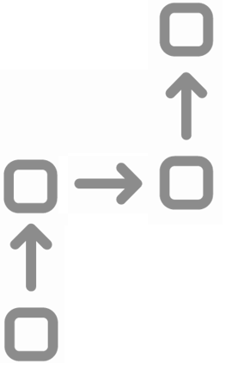
Abstractive (How it is done?)
It follows an Encoder-Decoder Architecture
Creates a Semantic/Structured representation of the text (Encoding)
Recreates the sentences from the Semantic/Structure representation (Decoding)
Once the network is trained it can be tested on text to evaluate it

Slide 11
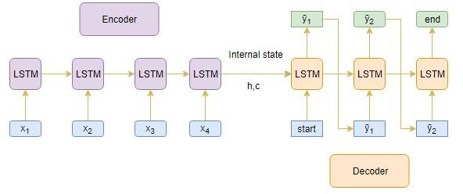
Abstractive (Encoding/Decoding)
Several types of neural networks are used as Encoders/Decoders:
Recurrent Neural Networks (RNNs)
Convolutional Neural Networks(CNN)
Gated Recurrent Neural Network (GRU)
Long Short-Term Memory (LSTM)

Slide 12
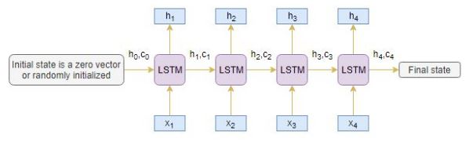
Abstractive Encoding (How it is done?)
1. A chain of the selected Neural networks (Node) are linked together
2. Each node takes an initialization value and the next word in the sentence.
3. The nodes feed their outputs as the initialization value for the next node.

Slide 13
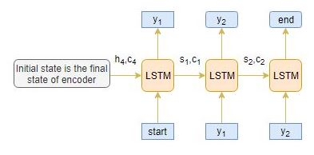
Abstractive decoding (How it is done?)
A chain of the selected Neural networks (Node) are linked together.
Each node takes the output initialization value of the encoder chain as the initialization value for the decoder.
The decoder is given a Start token and predicts the next token as its output. This predicted token is taken as the input for the next node.
The sentence is summarized when a defined end token or word limit is reached.

Slide 14
Abstractive Text Summarization
Soumye Singhal
Department of Computer Science
IIT Kanpur
soumye@cse.iitk.ac.in
Arnab Bhattacharya
Department of Computer Science
IIT Kanpur
arnabb@cse.iitk.ac.in

Slide 15
Abstractive Text Summarization
“Neural Sequence to Sequence attention models have shown promising results in
Abstractive Text Summarization. But they are plagued by various problems. The
summaries are often repetitive and absurd. We explore and review different techniques
that can help overcome these issues.”
Baseline Model
Define Metrics
Suggest Improvements
Notes:
Extractive approaches are easier and can be hard coded to select the text that matters, it almost always have a correct grammar (Depending on the original text of course) yet they fall short when it comes to long complex texts

Slide 16
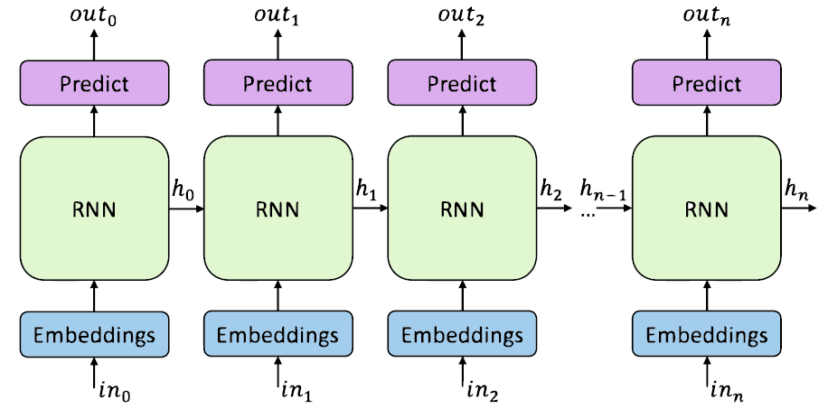
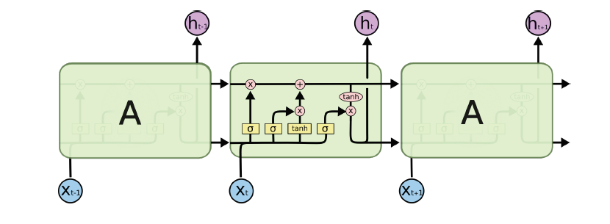
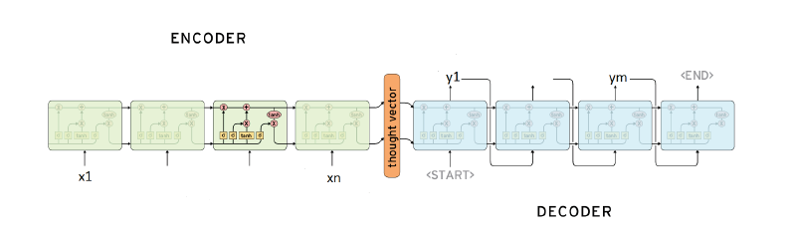
Baseline Attention Model
Baseline Model is a Neural attention Model with Encoding – Decoder implementation, where the text is encoded into hidden layer and then the decoder decodes the hidden layer to produce the summary
Bi-Directional RNN - LSTM
Notes:
The Deep neural model purposed by Bahdanau et al. [2014] consists mainly of an encoder-decoder recurrent Neural network with attention Mechanism
Team used bi-Directional RNN where they scanned both ends of the input (Left and Right)

Slide 17
Metrics
Grammatically correct and Human readable
ROUGE : ROUGE is simply a string-matching Metric
ROUGE-N measure N-Gram similarity ,
ROUGE-L which measure Sentence level similarity and
ROUGE-S which is Skip-gram Similarity
Target Summary Present
Metrics…
Target Summary Absent
Topic Modeling

Slide 18
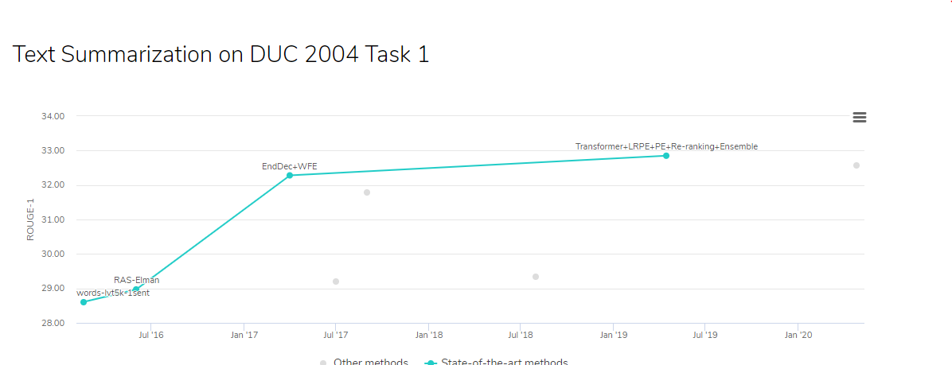
Datasets
DUC-2004
Gigaword
Notes:
DUC is Document Understanding Conferences
Gigaword consisting of around 4 million articles.
Source https://paperswithcode.com/sota/text-summarization-on-duc-2004-task-1

Slide 19
Suggested Improvements
Large Vocabulary
Hierarchical Attention
Pointer Generator Network
Coverage Mechanism
Intra-Attention on Decoder Output
Learning From Mistakes using reinforced learning

Slide 20
Large Vocabulary
Use more linguistic rich features for the input like POS (Part of speech), named-Entity and TF-IDF Speeds training , yet surprisingly decrease abstractive Capabilities
Author didn’t share exactly the training speed gained vs scoring in the metric lost.
Worth mentioning that we faced the same on Coursework1

Slide 21
Hierarchical Attention
The team recommends the use of Hierarchical attention, no detail on its metric improvement score
In Hierarchical Attention Networks for Document Classification paper, it proposed hierarchical attention networks (HAN) , obtained better visualization using the highly informative components of a document. The model progressively constructs a document vector by aggregation of words into sentence and then sentences into document..
Hierarchical Attention Networks for Document Classification, ichao Yang1 , Diyi Yang1 ,

Slide 22
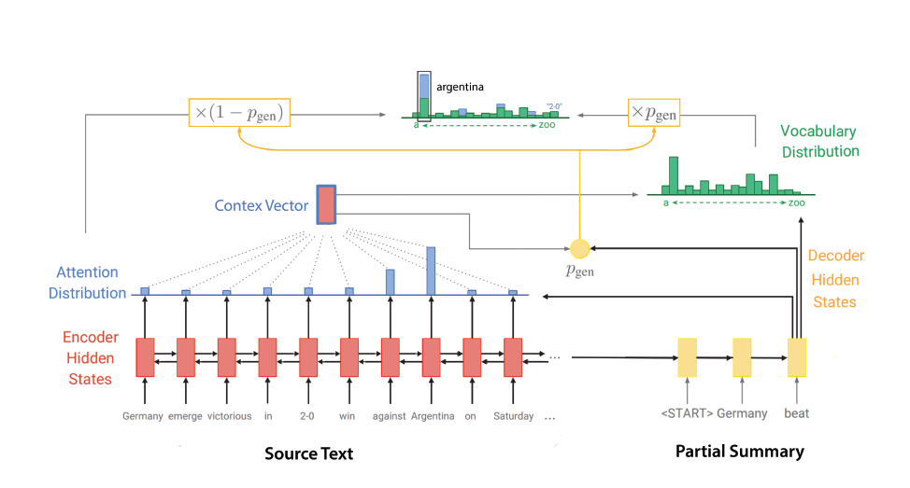
Pointer Generator Network and Coverage Mechanism
Solves the out of vocab problem (UNK) by copying from (Pointing) to the source while avoiding repetition
Coverage model is simply done by
Summing all the attention and penalizing the things that already been covered
In Advances in Neural Information Processing Systems 28 (NIPS 2015) paper, addressed the challenge of number of target classes in eachstep of the reliance of the output on the length of the input,
Advances in Neural Information Processing Systems 28 (NIPS 2015)

Slide 23
Intra-Attention on Decoder Output
Same like Coverage Mechanism but consider also Decoder output , this avoids repeating words that has been generated already
Notes:
While coverage model make sure we don’t repeat the source text, Intra-Attention makes sure we don’t repeat our Decoder as well

Slide 24
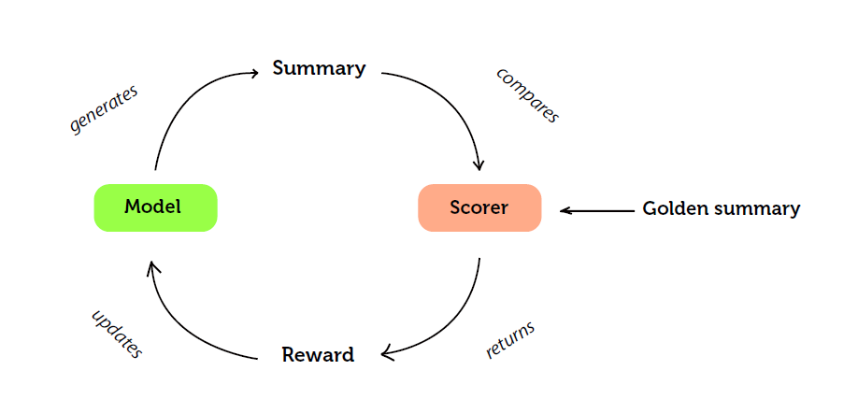
Learning From Mistakes using reinforced learning
We sample the next word from the output of the previous step
The Major challenge in Text Summarization between testing and real implementation is real world problem.
Note :All the text we use (Like in our Class) are correct (aka Shakespear )
The challenge in real word is incorrect text , and how the model can recover
The model output is compared to the reference summary using ROUGE metric , then iterate using Reinforced learning till we get a high score ROUGE score
Notes:
We sample the next word from the output of the previous step
The Major challenge in Text Summarization between testing and real implementation is real world problem. All the text we use (Like in our Class) are usually correct (aka Shakespear )
The challenge in real word is errors in text , and how the model can recover

Slide 25
Current Challenges
Metric
ROUGE and text Similarity is not a good measure for abstractive Text Summarization especially how our brain interpret a good summary
Datasets
Most of the Datasets available online are news, where you can get a relatively good summary by considering the top sentences

Slide 26
Our Findings
No insights on results
The authors in many ways didn’t provide detailed insights of the recommendations or the experiment.
Metrics
we do have a major concern on the Metrics used, we believe that the use of ROUGE and topic modeling is not suitable for measuring the objective and improvements they mentioned in the purpose of the paper especially if there is error in the given text. The Author also acknowledged this.
Challenges with Abstractive models
The trained model is limited to its known vocabulary (The text it is trained on) and may not be able to summarise important Out Of Vocabulary (OOV) words.
Salient words might not be detected during training leading to inaccurate summaries.
Limited quality datasets to train the network leads to above challenges
Summaries are limited by needing start and end tokens to be defined or setting sentence length limits.
Focus on technology
To prepare for this classwork we have went through several research papers, we found that most of the papers ,including this one, focus on the technology and not the user , none of them suggested any improvements based on the user preferences, no consideration to user location, mother tongue or preferences . we believe text summarization should incorporate and be tuned for other parameters and including the context of the original text and adjust the model parameters accordingly

Slide 27
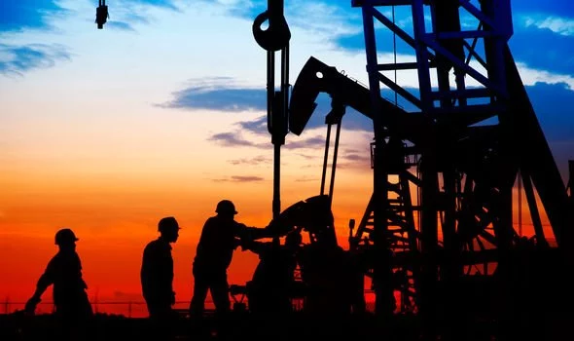
Extractive Text Summarization
Notes:
Summary don’t need to come from the same text

Slide 28
Extractive Summarization
Extracting important complete sentences from text
No change in the sentences extracted
Document
Sentence 1
Sentence 2
Sentence 3
Sentence 4
Summary
Sentence 1
Sentence 4
Extractive

Slide 29

Extractive (How it is done?)
It is done in 3 phases:
Build representation of the text (Preprocessing)
Score sentences in built representation
Select k most important sentences to be our summary

Slide 30
Extractive (Preprocessing)
This phase involves four stages:
1. Sentence Segmentation
2. Tokenization
3. Stop word Removal
4. Stemming/Lemmetization
Article
Text
Sentences
Stem/Lemm
Stop word Remove
Words

Slide 31
Extractive (Representation)
Most common approaches:
1. Frequency based representation
2. Semantic similarity representation
3. Vector similarity representation
4. Graph based representation
Article
Text
Sentences
Representation
Vector
…
Graph

Slide 32
Extractive (Scoring)
After phase 1, sentences are scored based on factors such as frequency, semantics, similarity, position of sentence or word.

Slide 33
Extractive (Scoring) Contd.
Frequency based Scoring
If the number of times a word occurred in a document is high, then it has importance in the content of that document. Thus higher score.
Common methods used:
Word Probability
Bag of Words (BoW)
Term Frequency - Inverse Document Frequency (TF-IDF)

Slide 34
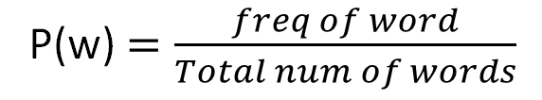
Frequency based Scoring (Word Probability)
Is the number of occurrences of a word divided by the total number of words.
P(w) $=\frac{freq of word}{Total num of words}$
Text Summarization Techniques: A Brief Survey 2017

Slide 35
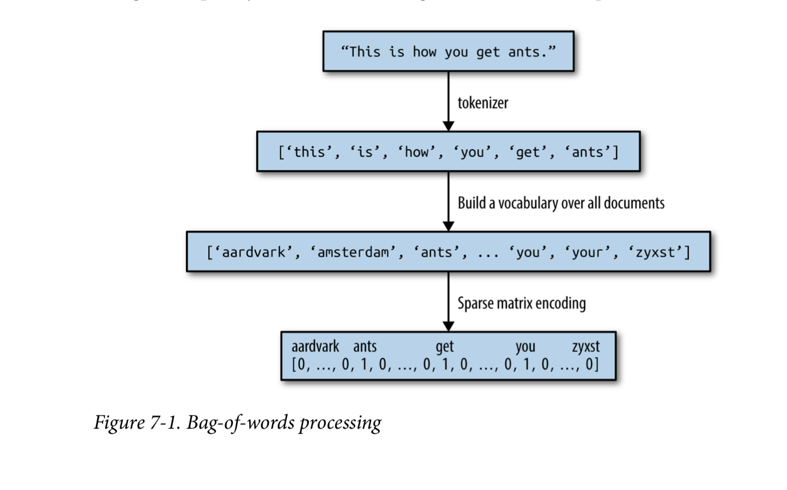
Frequency based Scoring (Bag of Words)
Bag of words is a vector with size equal to all words in our document. A BoW representation of a sentence is the the same vector with frequencies of words occurred in this sentence.

Slide 36
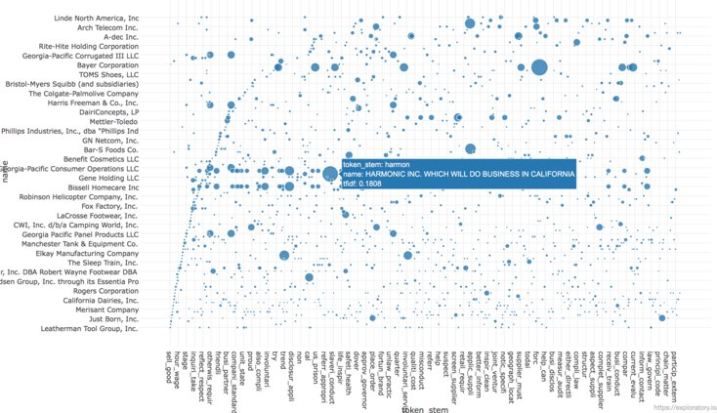
Frequency Based Scoring (TF-IDF)
TF: number of documents contain t
IDF: total number of documents divided by documents containing t

Slide 37
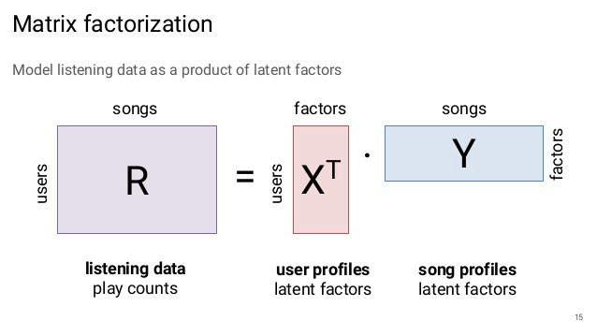
Extractive (Scoring) Contd.
Semantic based Scoring
LSA

Slide 38
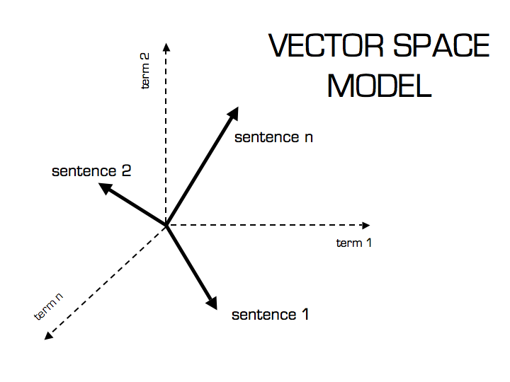
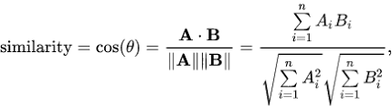
Extractive (Scoring) Contd.
Similarity based Scoring
Vector rep. of sentence
Euclidian dist or cosine dist.
Centroid based similarity

Slide 39
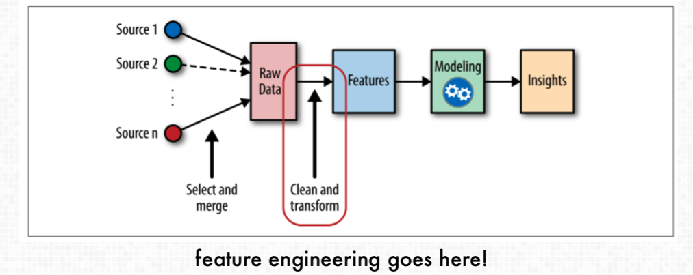
Extractive (Scoring) Contd.
Feature Based Scoring
Hand authored features
Domain specific features

Slide 40
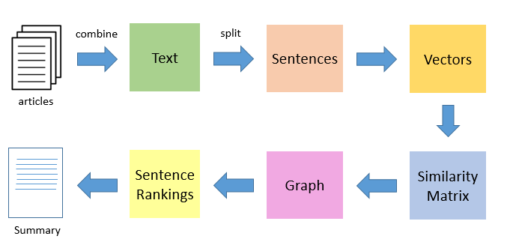
Extractive (Generation)
Sentence Ranking
Centroid based ranking
Accumulative ranking
TextRank

Slide 41
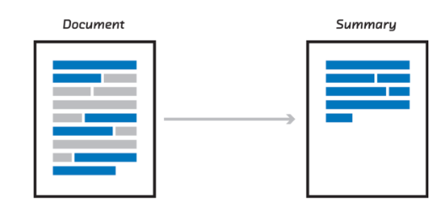
Extractive (Generation)
Summary Selection
Summary Budget
Summary Constuction

Slide 42
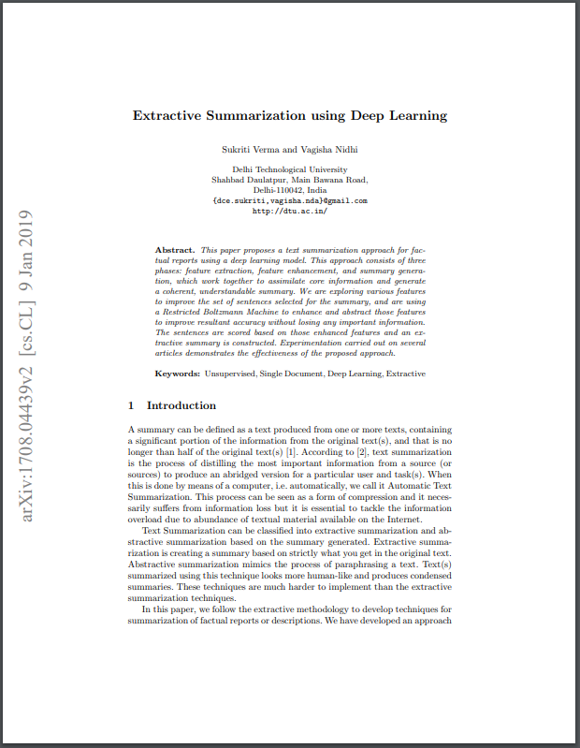
Case Study - A: Overview
Abstract
Approach

Slide 43
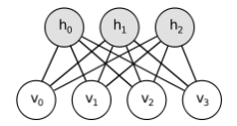
Case Study - A: Models - RBM
Boltzmann machines are stochastic and generative neural networks capable of learning internal representations and can represent and (given sufficient time) solve difficult combinatoric problems.
Boltzmann machines are non-deterministic (or stochastic) generative Deep Learning models with only two types of nodes — hidden and visible nodes. There are no output nodes! This may seem strange, but this is what gives them this non-deterministic feature.
unlike the other traditional networks (A/C/R) which don’t have any connections between the input nodes, a Boltzmann Machine has connections among the input nodes.

Slide 44
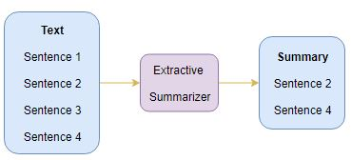
Case Study - A: Architecture
Pre-processing
Feature Extraction
Feature Enhancement
Summary Generation

Slide 45

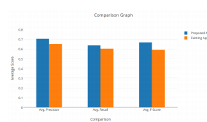
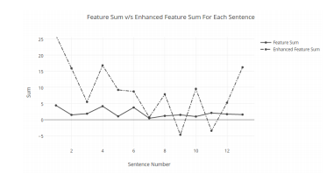
Case Study - A: Experiments
Benchmarks Used
Results

Slide 46
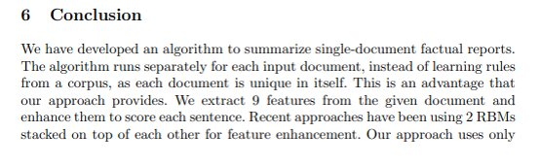
Case Study - A: Conclusion
Conclusion
Our Findings

Slide 47
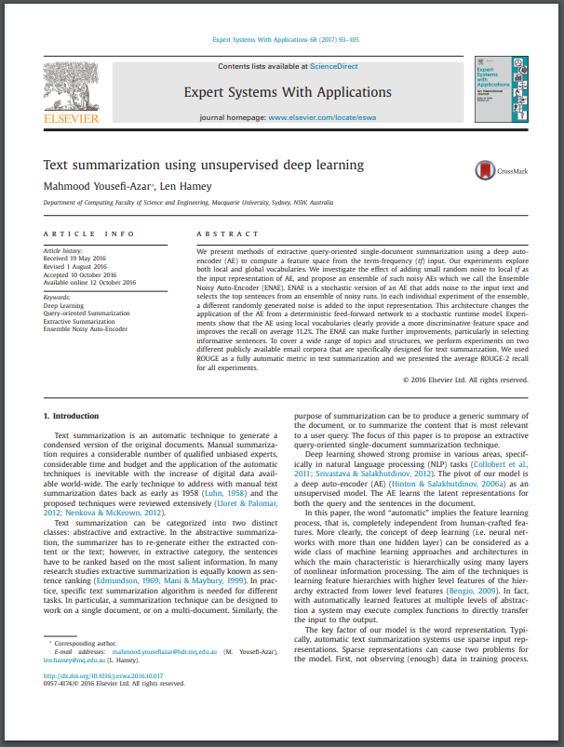
Case Study - B: Overview
Yousefi et al use an Auto Encoder (AE) a type of unsupervised deep learning neural network to refine the features in the term frequencies of a document for summarization.
First a chain of Restricted Boltzmann Machines are used to refine the weights for the text features.
The weights are then used in the Auto encoder to generate a summary

Slide 48
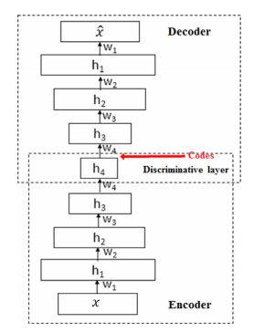
Case Study - B: Models - Autoencoder
The AE neural network is feed forward network, the main feature of this network is the bottleneck in it hidden layer, its input and output layers have the same number of nodes and the network replicates its input as its output.
The case study uses this reconstructive ability by adding random noise to their inputs, by doing this the most salient features would be elicited by the encoder.
The study used several encoders with different random noise masks this created several feature maps.
Using multiple maps the most prominent features across all maps were found and these features were used to generate the summary.

Slide 49
Evaluation Techniques
ROUGE, or Recall-Oriented Understudy for Gisting Evaluation are a set of metrics that are used to evaluate the results of NLP applications such as Machine translation, Auto Summarization etc.
There are five metrics that are used to evaluate NLP results:
Rouge-1: Unigram Overlap
Rouge-2: Bigram Overlap
Rouge-L: Longest Common Sequence (LCS)
Rouge-W: Weighted LCS
Rouge-S: Skip Bigram
Rouge-SU: Co-occurrence of Rouge-S and Rouge-1
Notes:
1.single word overlap of reference and result
2.double word overlap of reference and result
3.long sentence overlap of reference and result
4.weight given to consecutive lcs
5.Word pair occurrence between reference and result
6.What it says

Slide 50
References
Quantifying documents by calculating tf-idf in R
Introduction to Latent Matrix Factorization recommender Systems
Comprehensive guide to text summarization using deep learning
Feature engineering framework techniques
https://medium.com/@social_20188/text-summarization-cfdbbd6fb800
https://www.analyticsvidhya.com/blog/2018/11/introduction-text-summarization-textrank-python/
O. Foong, S. Yong and F. Jaid, "Text Summarization Using Latent Semantic Analysis Model in Mobile Android Platform," 2015 9th Asia Modelling Symposium (AMS), Kuala Lumpur, 2015, pp. 35-39.
Gupta, Som & Gupta, S. K, 2019. Abstractive summarization: An overview of the state of the art. Expert Systems With Applications, 121, pp.49–65.

Slide 51
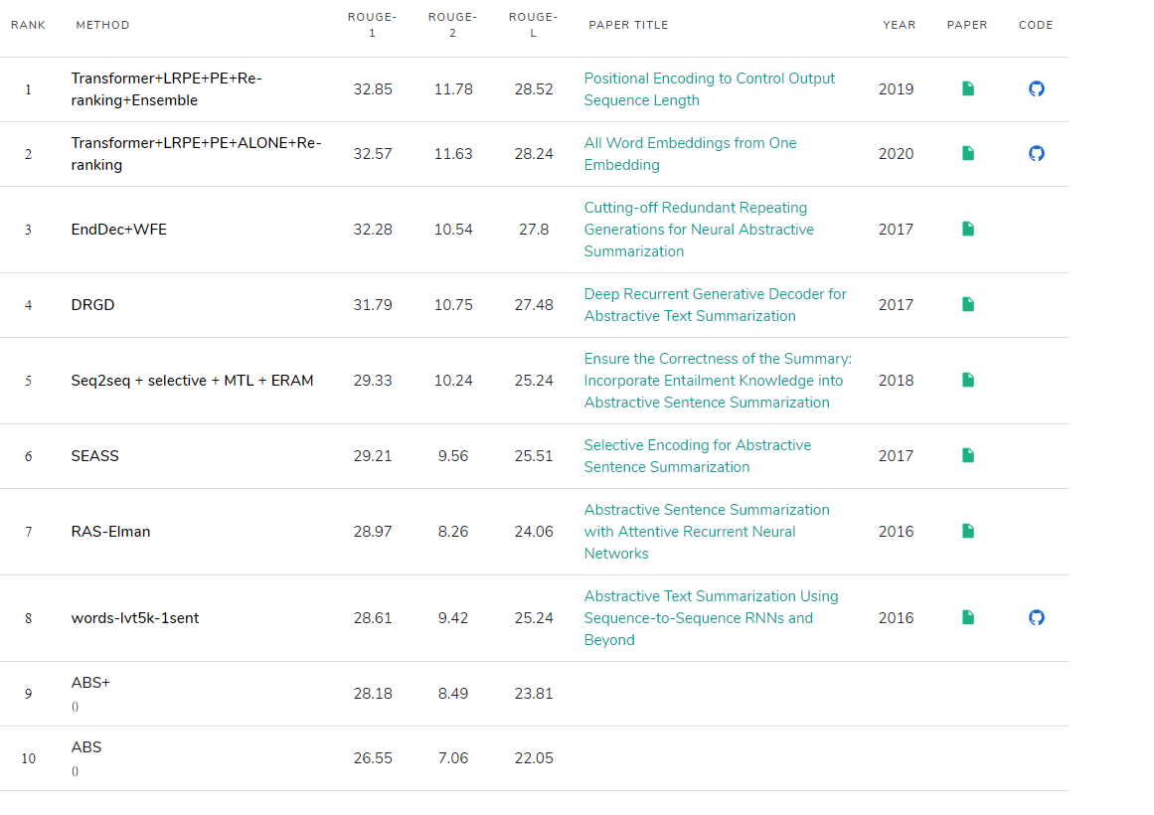
Different Papers Rouge score
Notes:
https://paperswithcode.com/sota/text-summarization-on-duc-2004-task-1

Slide 52
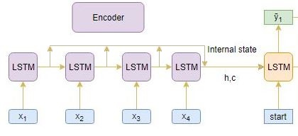
Attention Mechanism
Due to the chained nature of the Encoder Decoder Architecture, the initialization variable is transformed through the chain.
The chain discards the intermediate variable between nodes.
The Attention Mechanism preserves the intermediate variables and combines it with the final output.

